Slide 1
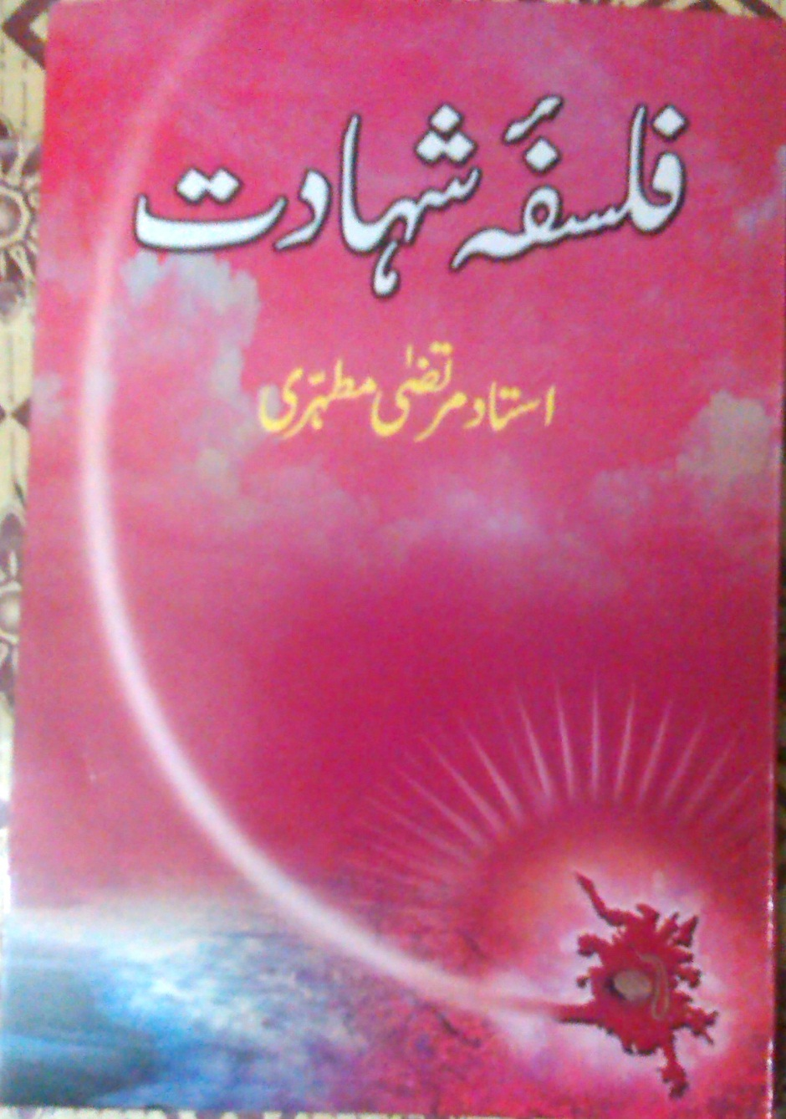
FALSAFA-E- SHAHADAT
USTAAD MURTAZA MOTAHARI

Slide 2
INFORMATION
Taleef : Ustaad Murtaza Motahari
Tarjuma : Mohammad Fazal Haq
Nazar e sani : Raza Hussain Rizwani
Kitabat : Syed Jaffer Sadiq
Tab-a punjm : 2006

Slide 3
INDEX
Shaheed---------------nazd e khoda
Shaheed---------------ka badan
Shaheed---------------ka taqaddus
Shaheed---------------ka ishtiyyaq
Shaheed---------------ki mantiq
Shaheed---------------ka khoon
Shaheed---------------ki shifa-at

Slide 4
SHAHEED NAZD E KHUDA
Shahadat ek moqaddas rutba
Shaheed doosron ka mohsin
Shaheed ek shama ki manind
Hazoor(S.A.W.W) ek roshan chiragh (Sorah Ahzab)

Slide 5
SHAHEED KA BADAN
Shaheed ko dafan karna
Taharat

Slide 6
SHAHEED KA TAQADDUS
Shahadat is qadar muqaddas kun?
Maut ki aqsaam
Tabii maut
Hadsaati maut
Jurm kay natijay may maut

Slide 7
CONTINUED….
4. Khud kushi
5. Shahadat
Shahadat kay do pehloo
Imam Hussain (A.S) ki misaal

Slide 8
SHAHEED KA ISHTIYYAQ
Shoqa-e-shahadat
Imam ali (a.s) ka shauq
Surah Ankaboot may irshad hota hai:
“Kya Logon Nay Samjh Lya Hai Kay Faqat Etna Kehnay Say Kay Ham Eman Lai, Unhay Chor Dya Jai Ga Aur Un Ka Imtayhan Nhi Lya Jai Ga”

Slide 9
CONTINUED….
Sabar ka nahi, shukar ka muqaam
Logon may shahadat ka shauq
Shahadat ki dua
KHESMA ka waqia
“Bistar Par Marnay Kay Bajaii, May Ye Zyada Pasand Karta Ho Kay Mayray Sar Par Talwar Ki Hazar Zarbay Lag Jai, Jin Kay Natejay May Main Maara Jaun” MOLA ALI(A.S)

Slide 10
SHAHEED KI MANATIQ
Mokhtalif andaza-e-fikr
Mantiq ( ishq ki aur moslah ki mantiq)
Imam Hussain (A.S) ki mantiq aam insano say mokhtalif

Slide 11
SHAHEED KA KHOON
Shaheed kya karta hai?
Shaheed ka khoon kabhi ra-egaa nhin jaata
Rasool (S.A.W.W) farmatay hay:
“Allah Kisi Qatray Ko Etna Pasand Nhi Karta, Jitna Us Khooon Kay Qatray Ko Pasand Karta Hai, Jo Us Ki Rah May Behta Hai”

Slide 12
SHAHEED KI SHIFA-AT
Teen (3) qisim kay log shifa-at karay gay
Mola ali(a.s) farmatay hay:
“Allah Qayamat Kay Din Shohada Ko Is Shan o Shokat Aur Azmat Aur Nooraniyat Kay Sath Samnay Lai Ga Kay Ambya Karam Agar Sawar Hoon Gay To Un Ki Tazeem Ki Khatir Sawariyon Say Otar Paray Gay”

